Slide 1
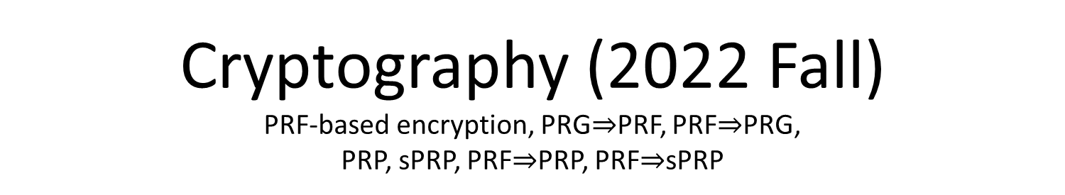
Cryptography (2022 Fall) PRF-based encryption, PRG$⇒$PRF, PRF$⇒$PRG, PRP, sPRP, PRF$⇒$PRP, PRF$⇒$sPRP
LiangFeng Zhang
zhanglf@shanghaitech.edu.cn
SIST, ShanghaiTech

Slide 2
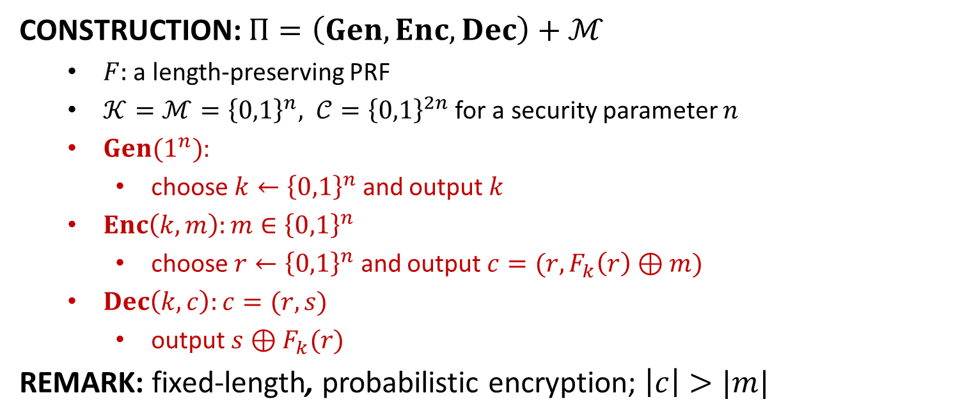
IND-CPA from PRF
CONSTRUCTION: $Π=\left(Gen,Enc, Dec\right)+ℳ$
$F:$ a length-preserving PRF
$𝒦=ℳ={\left\{0,1\right\}}^{n}, 𝒞={\left\{0,1\right\}}^{2n}$ for a security parameter $n$
$Gen(1^{n})$:
choose $k←{\left\{0,1\right\}}^{n}$ and output $k$
$Enc\left(k,m\right):m∈{\left\{0,1\right\}}^{n}$
choose $r←{\left\{0,1\right\}}^{n}$ and output $c=(r,F_{k}\left(r\right)⊕m)$
$Dec\left(k,c\right):c=(r,s)$
output $s⊕F_{k}(r)$
REMARK: fixed-length, probabilistic encryption; $\left|c\right|>|m|$

Slide 3
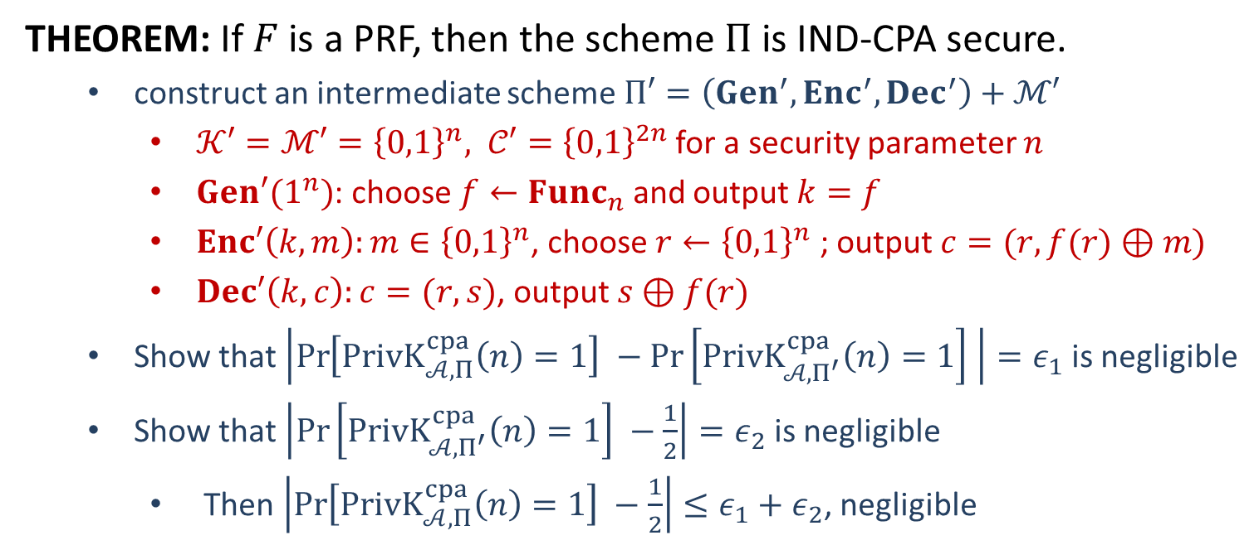
Security
THEOREM: If $F$ is a PRF, then the scheme $Π$ is IND-CPA secure.
construct an intermediate scheme $Π′=\left(Gen^{′},Enc^{′}, Dec^{′}\right)+ℳ′$
$𝒦′=ℳ′={\left\{0,1\right\}}^{n}, 𝒞′={\left\{0,1\right\}}^{2n}$ for a security parameter $n$
$Gen′(1^{n})$: choose $f←Func_{n}$ and output $k=f$
$Enc′\left(k,m\right):m∈{\left\{0,1\right\}}^{n}$, choose $r←{\left\{0,1\right\}}^{n}$ ; output $c=(r,f(r)⊕m)$
$Dec′\left(k,c\right):c=(r,s)$, output $s⊕f(r)$
Show that $\left|\operatorname{Pr}\left[PrivK_{𝒜, Π}^{cpa}\left(n\right)=1\right] −\operatorname{Pr}\left[PrivK_{𝒜, Π^{′}}^{cpa}\left(n\right)=1\right] \right|=ε_{1}$ is negligible
Show that $\left|\operatorname{Pr}\left[PrivK_{𝒜, Π^{′}}^{cpa}\left(n\right)=1\right] −\frac{1}{2}\right|=ε_{2}$ is negligible
Then $\left|\operatorname{Pr}\left[PrivK_{𝒜, Π}^{cpa}\left(n\right)=1\right] −\frac{1}{2}\right|≤ε_{1}+ε_{2}$, negligible

Slide 4








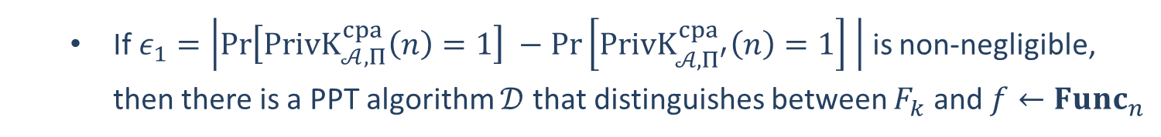














If $ε_{1}=\left|\operatorname{Pr}\left[PrivK_{𝒜, Π}^{cpa}\left(n\right)=1\right] −\operatorname{Pr}\left[PrivK_{𝒜, Π^{′}}^{cpa}\left(n\right)=1\right] \right|$ is non-negligible, then there is a PPT algorithm $𝒟$ that distinguishes between $F_{k}$ and $f←Func_{n}$
$$𝒪$$
$$𝒜$$
$$x_{i}$$
$$r_{i}$$
$$r_{i}←{\left\{0,1\right\}}^{n}$$
$$𝒪(r_{i})$$
$$(r_{i},𝒪\left(r_{i}\right)⊕x_{i})$$
$$m_{0},m_{1}$$
$$r$$
$$r←{\left\{0,1\right\}}^{n}$$
$$\left|m_{0}\right|=|m_{1}|$$
$$b←\{0,1\}$$
$$𝒪(r)$$
$$(r,𝒪\left(r\right)⊕m_{b})$$
$$x_{i}$$
$$r_{i}$$
$$r_{i}←{\left\{0,1\right\}}^{n}$$
$$𝒪(r_{i})$$
$$(r_{i},𝒪\left(r_{i}\right)⊕x_{i})$$
$$b^{′′}=\left\{\begin{aligned}0 b^{′}≠b \\ 1 b^{′}=b\end{aligned}\right.$$
$$b′$$
$$𝒟$$

Slide 5
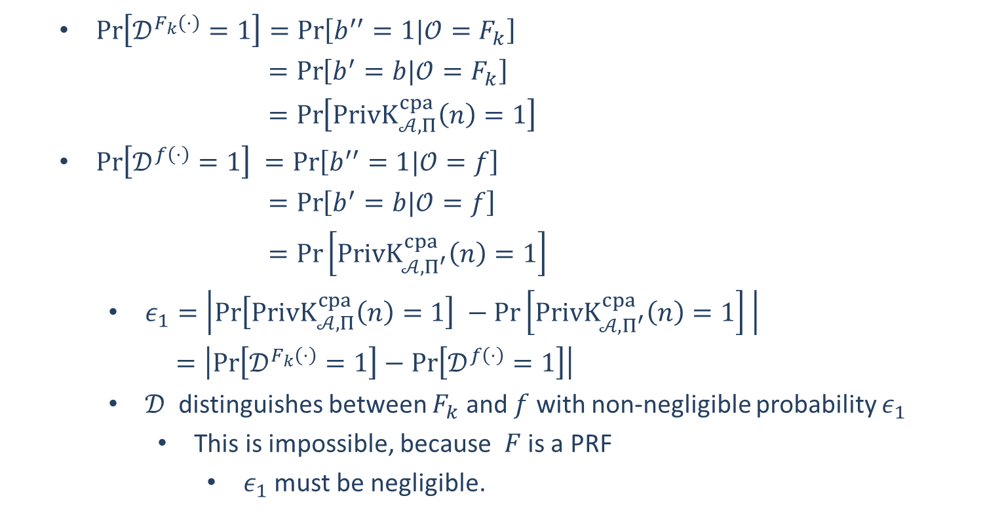
$\operatorname{Pr}\left[𝒟^{F_{k}\left(⋅\right)}=1\right]=\operatorname{Pr}\left[b^{′′}=1|𝒪=F_{k}\right]$
$=\operatorname{Pr}\left[b^{′}=b|𝒪=F_{k}\right]$
$=\operatorname{Pr}\left[PrivK_{𝒜, Π}^{cpa}\left(n\right)=1\right]$
$\operatorname{Pr}\left[𝒟^{f\left(⋅\right)}=1\right] =\operatorname{Pr}\left[b^{′′}=1|𝒪=f\right]$
$=\operatorname{Pr}\left[b^{′}=b|𝒪=f\right]$
$=\operatorname{Pr}\left[PrivK_{𝒜, Π^{′}}^{cpa}\left(n\right)=1\right]$
$ε_{1}=\left|\operatorname{Pr}\left[PrivK_{𝒜, Π}^{cpa}\left(n\right)=1\right] −\operatorname{Pr}\left[PrivK_{𝒜, Π^{′}}^{cpa}\left(n\right)=1\right] \right|$
$=\left|\operatorname{Pr}\left[𝒟^{F_{k}\left(⋅\right)}=1\right]−\operatorname{Pr}\left[𝒟^{f\left(⋅\right)}=1\right]\right|$
$𝒟$ distinguishes between $F_{k}$ and $f$ with non-negligible probability $ε_{1}$
This is impossible, because $F$ is a PRF
$ε_{1}$ must be negligible.

Slide 6

















Show that $ε_{2}=\left|\operatorname{Pr}\left[PrivK_{𝒜, Π^{′}}^{cpa}\left(n\right)=1\right] −1/2\right|$ is negligible.
Consider the IND-CPA security game of $Π^{′}$
$$f←Func_{n}$$
$$𝒜$$
$$x_{i}$$
$$r_{i}←{\left\{0,1\right\}}^{n}$$
$$(r_{i},f\left(r_{i}\right)⊕x_{i})$$
$$m_{0},m_{1}$$
$$\left|m_{0}\right|=|m_{1}|$$
$$r←{\left\{0,1\right\}}^{n}$$
$$challenger$$
$$b←\{0,1\}$$
$$(r,f\left(r\right)⊕m_{b})$$
$$x_{i}$$
$$r_{i}←{\left\{0,1\right\}}^{n}$$
$$(r_{i},f\left(r_{i}\right)⊕x_{i})$$
$$b^{′′}=\left\{\begin{aligned}0 b^{′}≠b \\ 1 b^{′}=b\end{aligned}\right.$$
$$b′$$

Slide 7
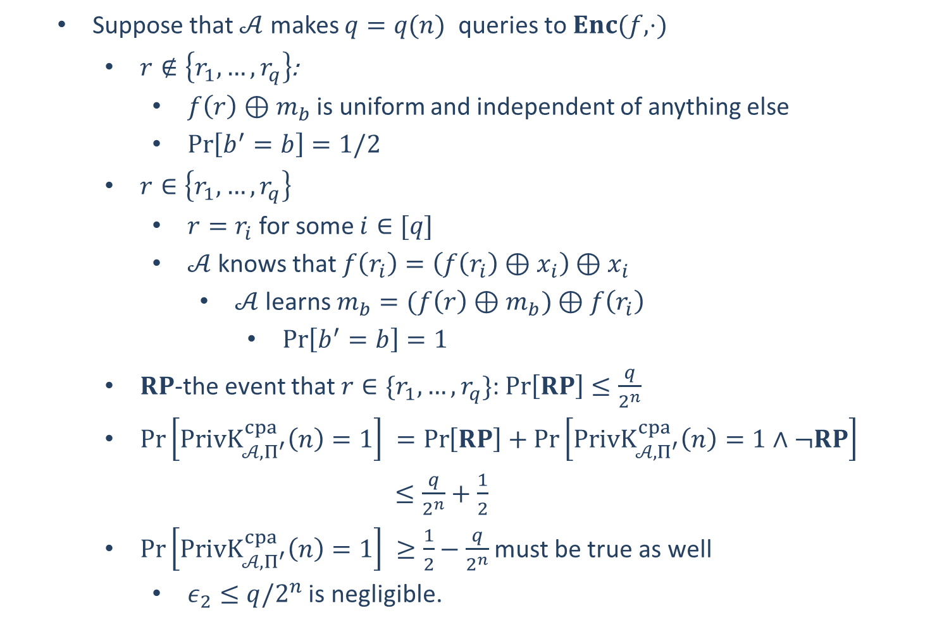
Suppose that $𝒜$ makes $q=q(n)$ queries to $Enc(f,⋅)$
$r∉\left\{r_{1},…,r_{q}\right\}$:
$f\left(r\right)⊕m_{b}$ is uniform and independent of anything else
$\operatorname{Pr}\left[b^{′}=b\right]=1/2$
$r∈\left\{r_{1},…,r_{q}\right\}$
$r=r_{i}$ for some $i∈[q]$
$𝒜$ knows that $f\left(r_{i}\right)=\left(f\left(r_{i}\right)⊕x_{i}\right)⊕x_{i}$
$𝒜$ learns $m_{b}=(f\left(r\right)⊕m_{b})⊕f\left(r_{i}\right)$
$\operatorname{Pr}\left[b^{′}=b\right]=1$
$RP$-the event that $r∈\{r_{1},…,r_{q}\}$: $\operatorname{Pr}\left[RP\right]≤\frac{q}{2^{n}}$
$\operatorname{Pr}\left[PrivK_{𝒜, Π^{′}}^{cpa}\left(n\right)=1\right] =\operatorname{Pr}\left[RP\right]+\operatorname{Pr}\left[PrivK_{𝒜, Π^{′}}^{cpa}\left(n\right)=1∧¬RP\right]$
$≤\frac{q}{2^{n}}+\frac{1}{2}$
$\operatorname{Pr}\left[PrivK_{𝒜, Π^{′}}^{cpa}\left(n\right)=1\right] ≥\frac{1}{2}−\frac{q}{2^{n}}$ must be true as well
$ε_{2}≤q/2^{n}$ is negligible.

Slide 9




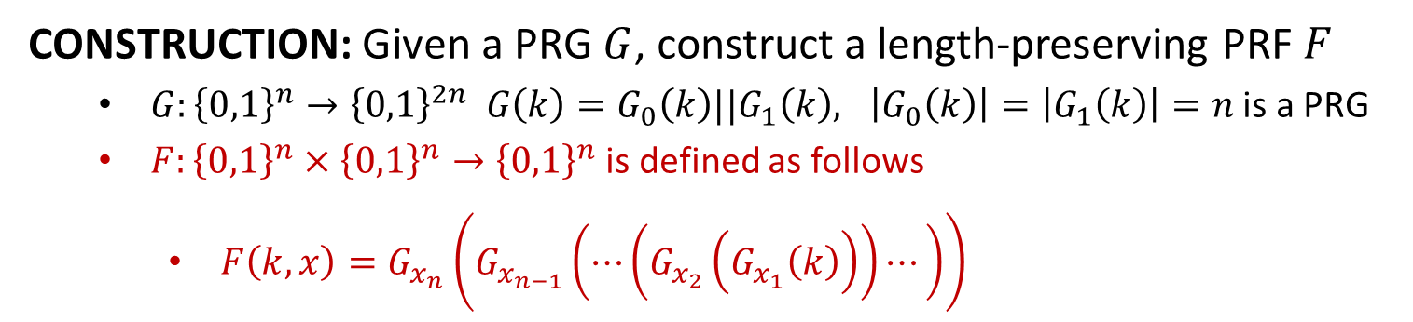






















PRF from PRG
CONSTRUCTION: Given a PRG $G$, construct a length-preserving PRF $F$
$G:{\left\{0,1\right\}}^{n}→{\left\{0,1\right\}}^{2n} G\left(k\right)=G_{0}\left(k\right)||G_{1}\left(k\right), \left|G_{0}\left(k\right)\right|=\left|G_{1}\left(k\right)\right|=n$ is a PRG
$F:{\left\{0,1\right\}}^{n}×{\left\{0,1\right\}}^{n}→{\left\{0,1\right\}}^{n}$ is defined as follows
$F\left(k,x\right)=G_{x_{n}}\left(G_{x_{n−1}}\left(⋯\left(G_{x_{2}}\left(G_{x_{1}}\left(k\right)\right)\right)⋯\right)\right)$
$$n=3$$
$$k$$
$$G_{0}$$
$$G_{1}$$
$$G_{0}(k)$$
$$G_{1}(k)$$
$$G_{0}$$
$$G_{1}$$
$$G_{0}$$
$$G_{1}$$
$$G_{0}$$
$$G_{1}$$
$$G_{0}$$
$$G_{1}$$
$$G_{0}$$
$$G_{1}$$
$$G_{0}$$
$$G_{1}$$
$$F_{k}(000)$$
$$F_{k}(001)$$
$$F_{k}(010)$$
$$F_{k}(011)$$
$$F_{k}(100)$$
$$F_{k}(101)$$
$$F_{k}(110)$$
$$F_{k}(111)$$

Slide 10
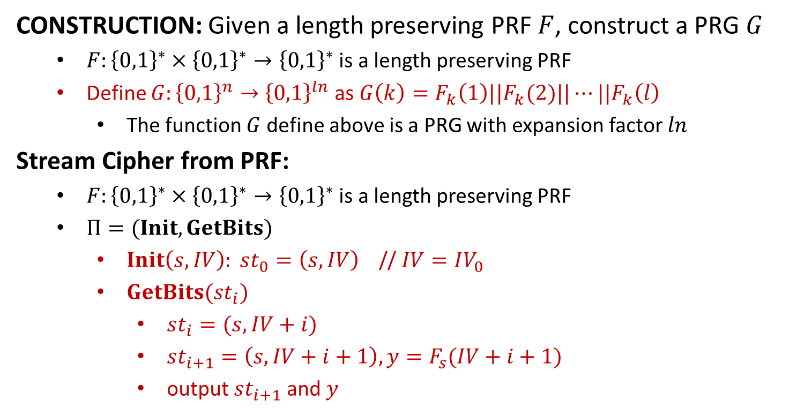
PRG from PRF
CONSTRUCTION: Given a length preserving PRF $F$, construct a PRG $G$
$F:{\left\{0,1\right\}}^{∗}×{\left\{0,1\right\}}^{∗}→{\left\{0,1\right\}}^{∗}$ is a length preserving PRF
Define $G:{\left\{0,1\right\}}^{n}→{\left\{0,1\right\}}^{ln}$ as $G\left(k\right)=F_{k}\left(1\right)||F_{k}(2)||⋯||F_{k}\left(l\right)$
The function $G$ define above is a PRG with expansion factor $ln$
Stream Cipher from PRF:
$F:{\left\{0,1\right\}}^{∗}×{\left\{0,1\right\}}^{∗}→{\left\{0,1\right\}}^{∗}$ is a length preserving PRF
$Π=(Init, GetBits)$
$Init\left(s,IV\right): st_{0}=\left(s,IV\right)$ // $IV=IV_{0}$
$GetBits(st_{i})$
$st_{i}=(s,IV+i)$
$st_{i+1}=\left(s,IV+i+1\right), y=F_{s}(IV+i+1)$
output $st_{i+1}$ and $y$

Slide 12
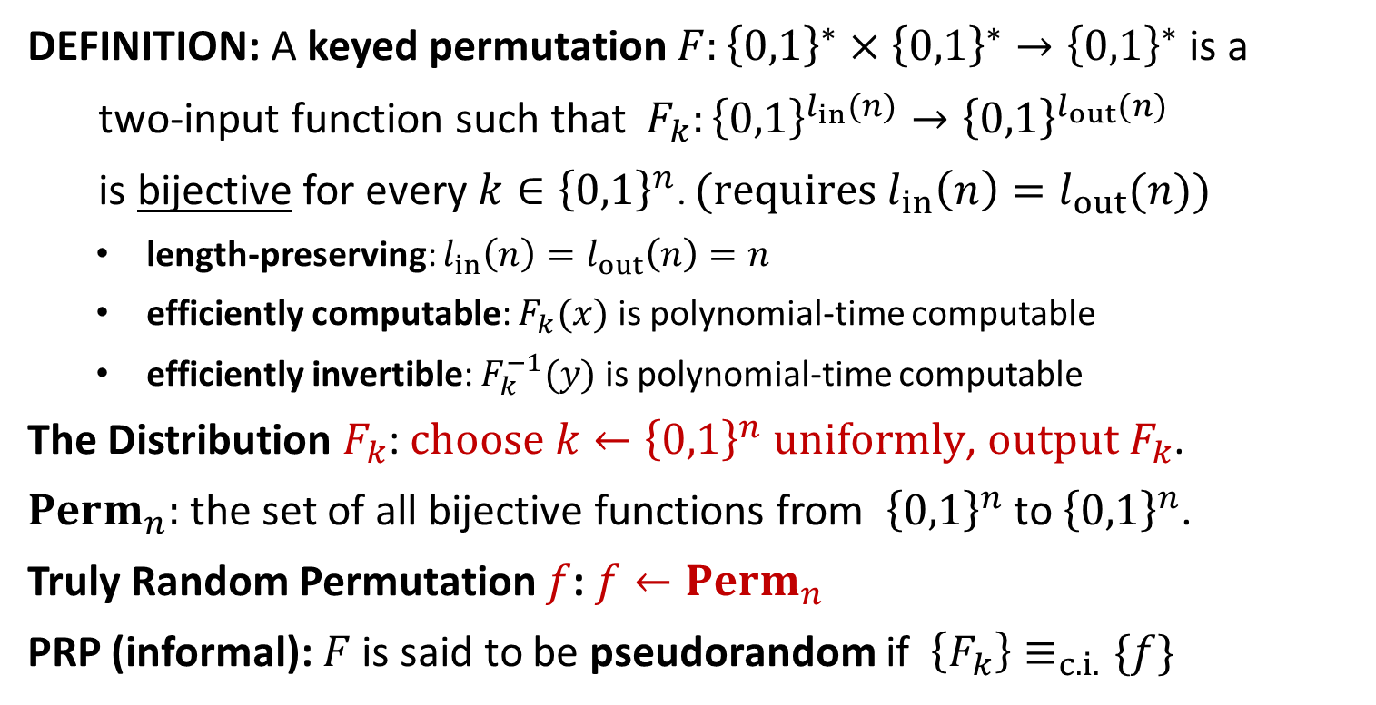
Pseudorandom Permutation
DEFINITION: A keyed permutation $F:{\left\{0,1\right\}}^{∗}×{\left\{0,1\right\}}^{∗}→{\left\{0,1\right\}}^{∗}$ is a
two-input function such that $F_{k}:{\left\{0,1\right\}}^{l_{in}(n)}→{\left\{0,1\right\}}^{l_{out}(n)}$
is bijective for every $k∈{\left\{0,1\right\}}^{n}$. $(requires l_{in}\left(n\right)=l_{out}(n))$
length-preserving: $l_{in}\left(n\right)=l_{out}\left(n\right)=n$
efficiently computable: $F_{k}(x)$ is polynomial-time computable
efficiently invertible: $F_{k}^{−1}(y)$ is polynomial-time computable
The Distribution $F_{k}$: $choose k←{\left\{0,1\right\}}^{n} uniformly$, $output F_{k}$.
$Perm_{n}:$ the set of all bijective functions from ${\left\{0,1\right\}}^{n}$ to ${\left\{0,1\right\}}^{n}$.
Truly Random Permutation $f$: $f←Perm_{n}$
PRP (informal): $F$ is said to be pseudorandom if $\left\{F_{k}\right\}≡_{c.i.}\{f\}$

Slide 13

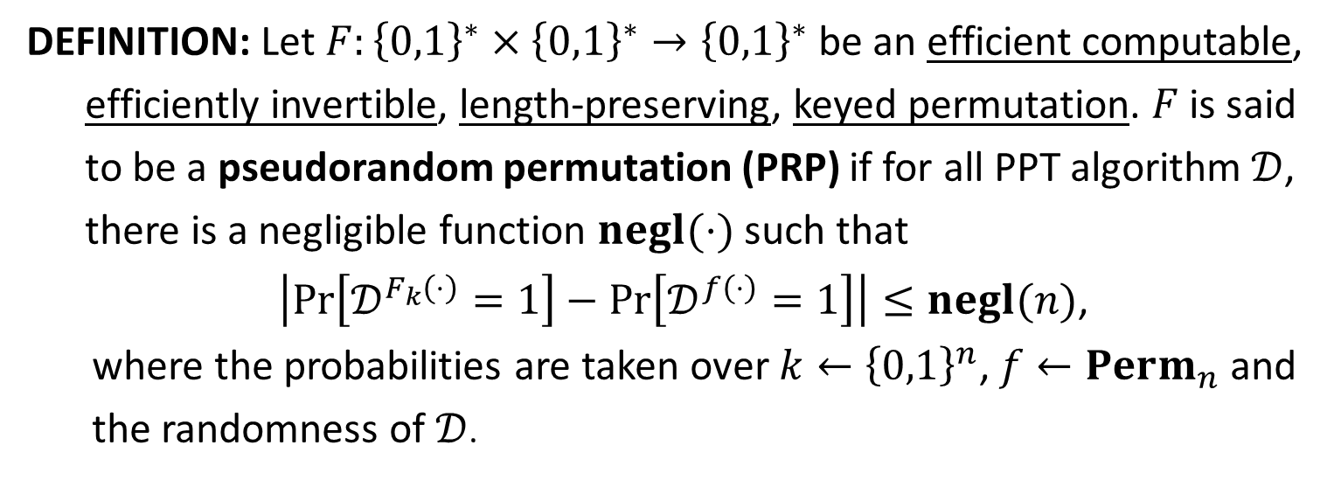


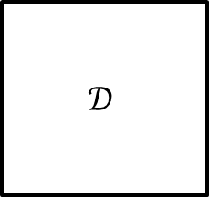
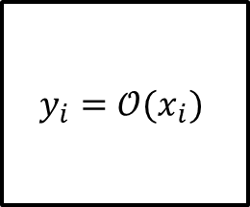

PRP
DEFINITION: Let $F:{\left\{0,1\right\}}^{∗}×{\left\{0,1\right\}}^{∗}→{\left\{0,1\right\}}^{∗}$ be an efficient computable,
efficiently invertible, length-preserving, keyed permutation. $F$ is said
to be a pseudorandom permutation (PRP) if for all PPT algorithm $𝒟$,
there is a negligible function $negl(⋅)$ such that
$\left|\operatorname{Pr}\left[𝒟^{F_{k}\left(⋅\right)}=1\right]−\operatorname{Pr}\left[𝒟^{f\left(⋅\right)}=1\right]\right|≤negl(n)$,
where the probabilities are taken over $k←{\left\{0,1\right\}}^{n}$, $f←Perm_{n}$ and the randomness of $𝒟$.
$$y_{i}=𝒪(x_{i})$$
$$𝒟$$
$$x_{1},x_{2},…,x_{q}$$
$𝒪=F_{k}$ or $f$
$$b$$
$$y_{1},y_{2},…,y_{q}$$
THEOREM: If $F$ is a PRP and $l_{in}\left(n\right)≥n$, then $F$ is a PRF.

Slide 14
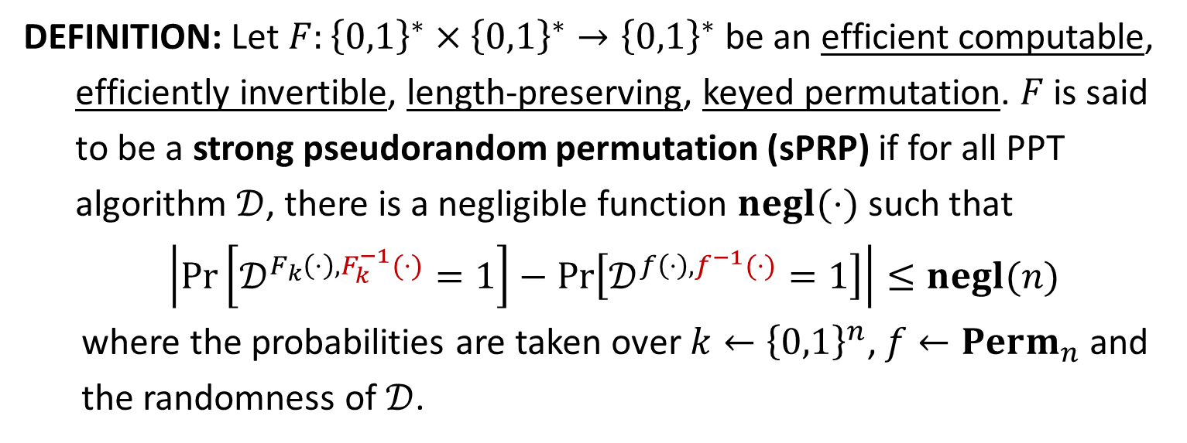




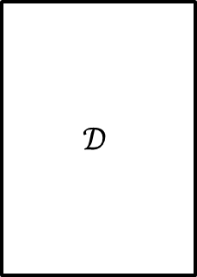
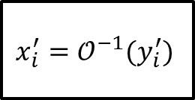
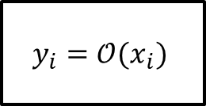

Strong PRP (Block Cipher)
DEFINITION: Let $F:{\left\{0,1\right\}}^{∗}×{\left\{0,1\right\}}^{∗}→{\left\{0,1\right\}}^{∗}$ be an efficient computable,
efficiently invertible, length-preserving, keyed permutation. $F$ is said
to be a strong pseudorandom permutation (sPRP) if for all PPT
algorithm $𝒟$, there is a negligible function $negl(⋅)$ such that
$\left|\operatorname{Pr}\left[𝒟^{F_{k}\left(⋅\right),F_{k}^{−1}(⋅)}=1\right]−\operatorname{Pr}\left[𝒟^{f\left(⋅\right),f^{−1}(⋅)}=1\right]\right|≤negl(n)$
where the probabilities are taken over $k←{\left\{0,1\right\}}^{n}$, $f←Perm_{n}$ and the randomness of $𝒟$.
$$y_{i}=𝒪(x_{i})$$
$$x_{1},x_{2},…,x_{q}$$
$$𝒟$$
$$y_{1},y_{2},…,y_{q}$$
$𝒪=F_{k}$ or $f$
$$b$$
$$x_{i}^{′}=𝒪^{−1}(y_{i}^{′})$$
$$y_{1}^{′},y_{2}^{′},…,y_{q^{′}}^{′}$$
$$x_{1}^{′},x_{2}^{′},…,x_{q^{′}}^{′}$$

Slide 15


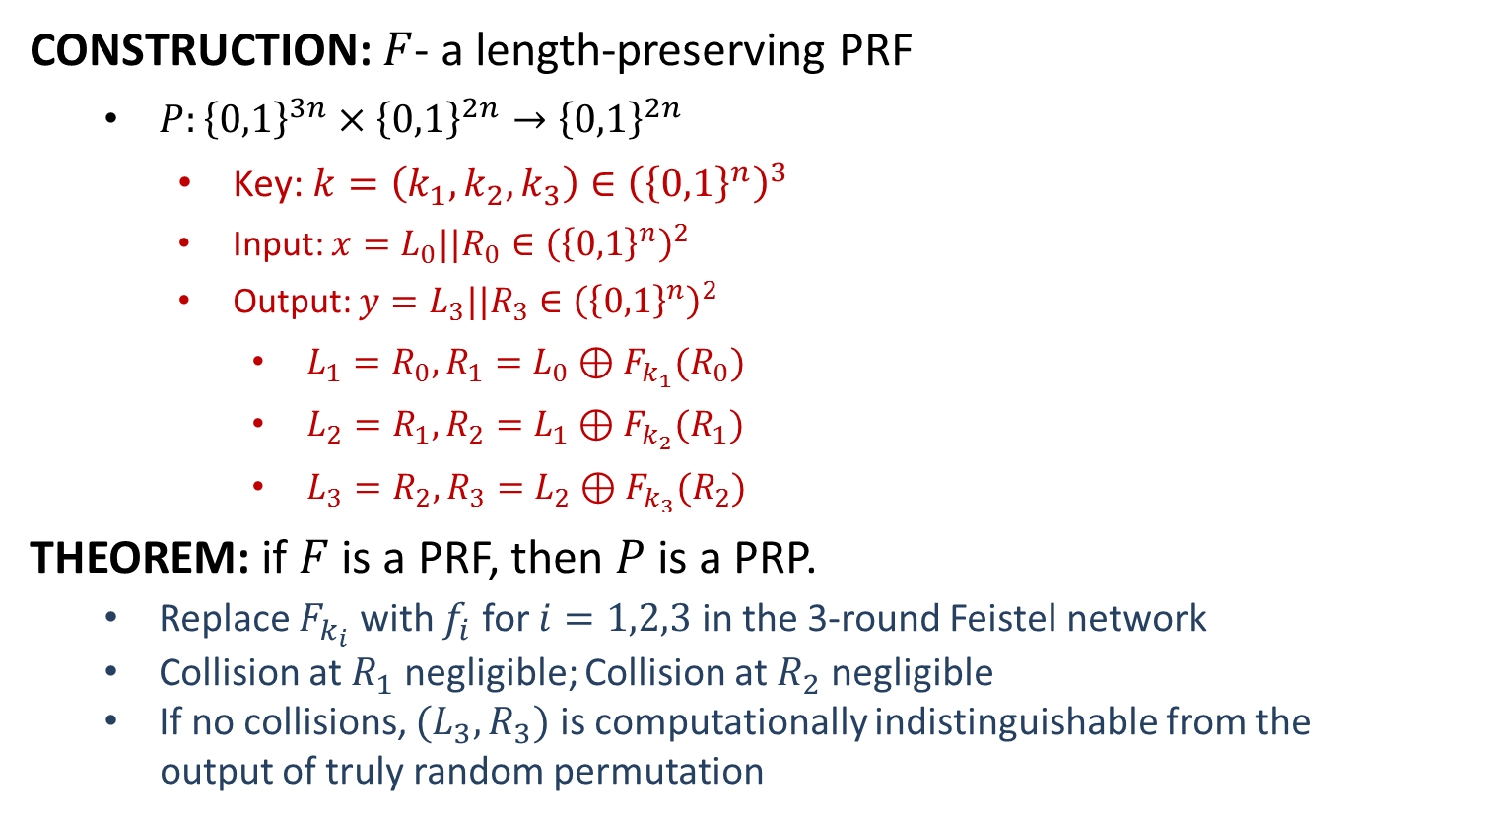












PRP from PRF
CONSTRUCTION: $F$- a length-preserving PRF
$P:{\left\{0,1\right\}}^{3n}×{\left\{0,1\right\}}^{2n}→{\left\{0,1\right\}}^{2n}$
Key: $k=\left(k_{1}, k_{2}, k_{3}\right)∈{\left({\left\{0,1\right\}}^{n}\right)}^{3}$
Input: $x=L_{0}||R_{0}∈{\left({\left\{0,1\right\}}^{n}\right)}^{2}$
Output: $y=L_{3}||R_{3}∈{\left({\left\{0,1\right\}}^{n}\right)}^{2}$
$L_{1}=R_{0}, R_{1}=L_{0}⊕F_{k_{1}}(R_{0})$
$L_{2}=R_{1}, R_{2}=L_{1}⊕F_{k_{2}}(R_{1})$
$L_{3}=R_{2}, R_{3}=L_{2}⊕F_{k_{3}}(R_{2})$
THEOREM: if $F$ is a PRF, then $P$ is a PRP.
Replace $F_{k_{i}}$ with $f_{i}$ for $i=1,2,3$ in the 3-round Feistel network
Collision at $R_{1}$ negligible; Collision at $R_{2}$ negligible
If no collisions, $(L_{3},R_{3})$ is computationally indistinguishable from the
output of truly random permutation
$$L_{0}$$
$$R_{0}$$
$$⨁$$
$$F_{k_{1}}$$
$$L_{1}$$
$$R_{1}$$
$$⨁$$
$$F_{k_{2}}$$
$$L_{2}$$
$$R_{2}$$
$$⨁$$
$$F_{k_{3}}$$
$$L_{3}$$
$$R_{3}$$

Slide 16

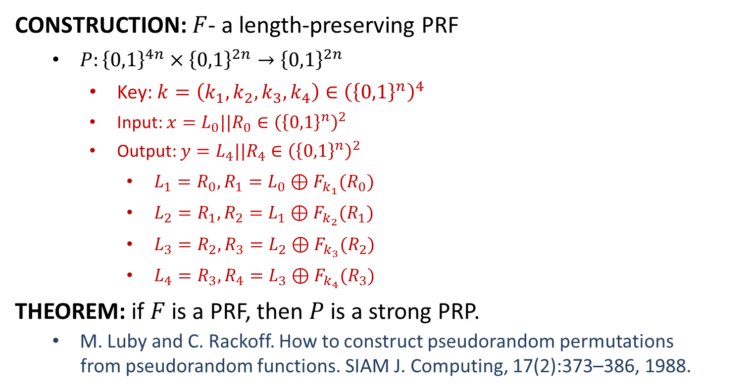





sPRP from PRF
CONSTRUCTION: $F$- a length-preserving PRF
$P:{\left\{0,1\right\}}^{4n}×{\left\{0,1\right\}}^{2n}→{\left\{0,1\right\}}^{2n}$
Key: $k=\left(k_{1}, k_{2}, k_{3},k_{4}\right)∈{\left({\left\{0,1\right\}}^{n}\right)}^{4}$
Input: $x=L_{0}||R_{0}∈{\left({\left\{0,1\right\}}^{n}\right)}^{2}$
Output: $y=L_{4}||R_{4}∈{\left({\left\{0,1\right\}}^{n}\right)}^{2}$
$L_{1}=R_{0}, R_{1}=L_{0}⊕F_{k_{1}}(R_{0})$
$L_{2}=R_{1}, R_{2}=L_{1}⊕F_{k_{2}}(R_{1})$
$L_{3}=R_{2}, R_{3}=L_{2}⊕F_{k_{3}}(R_{2})$
$L_{4}=R_{3}, R_{4}=L_{3}⊕F_{k_{4}}(R_{3})$
THEOREM: if $F$ is a PRF, then $P$ is a strong PRP.
M. Luby and C. Rackoff. How to construct pseudorandom permutations
from pseudorandom functions. SIAM J. Computing, 17(2):373–386, 1988.
$$L_{0}$$
$$R_{0}$$
$$⨁$$
$$F_{k_{1}}$$
$$L_{1}$$
$$R_{1}$$
$$⨁$$
$$F_{k_{2}}$$
$$L_{2}$$
$$R_{2}$$
$$⨁$$
$$F_{k_{3}}$$
$$L_{3}$$
$$F_{k_{4}}$$
$$R_{3}$$
$$⨁$$
$$L_{4}$$
$$R_{4}$$

